Slide 1



Slide 2
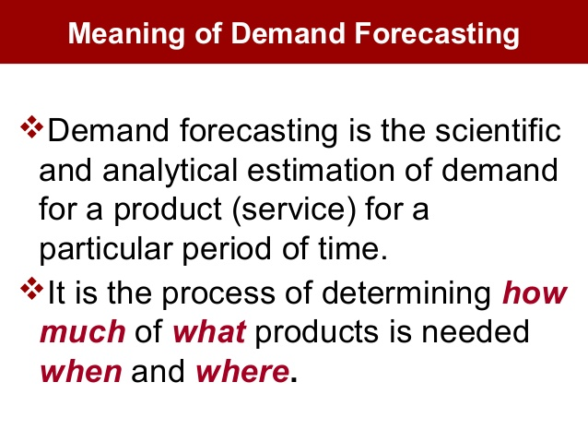

Slide 3
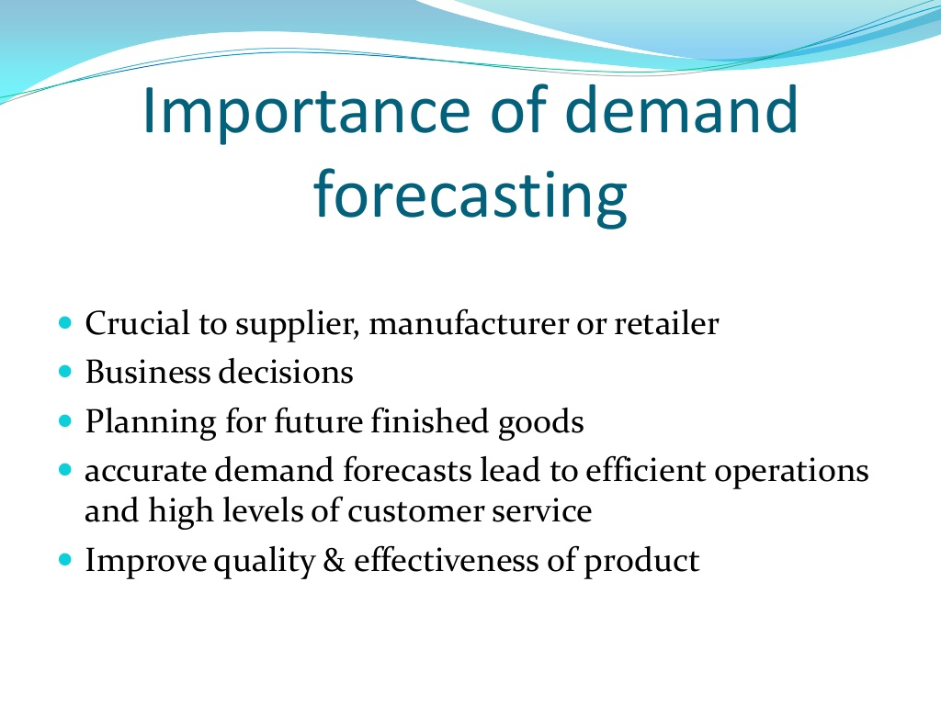

Slide 4
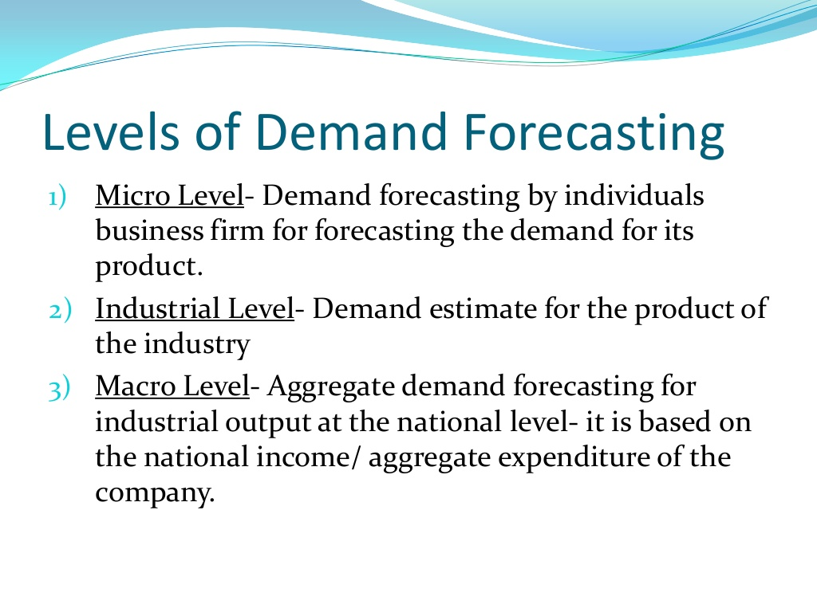

Slide 5
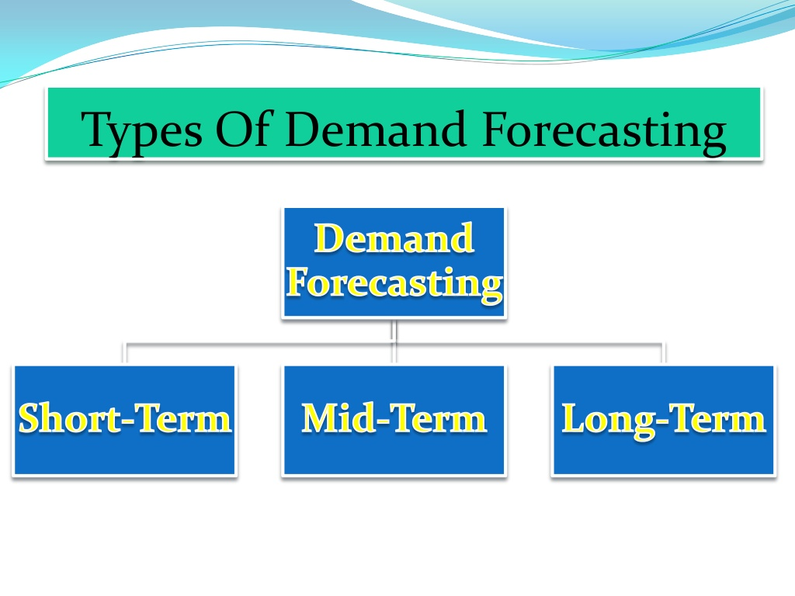

Slide 6
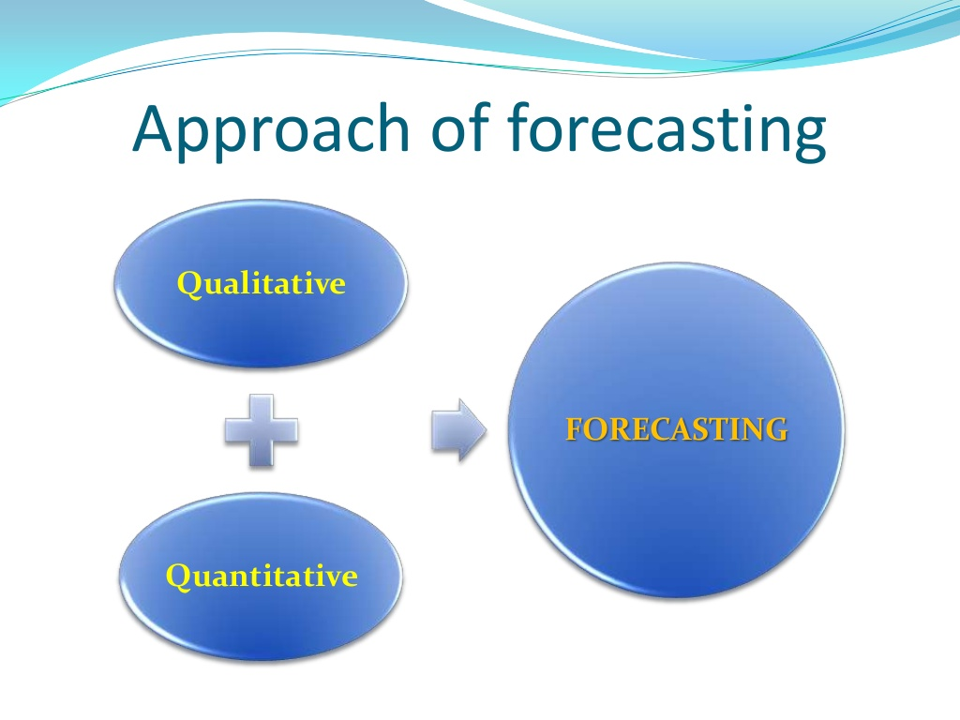

Slide 7
Qualitative Forecasting Method
Experts’ Opinion Poll
Delphi Method
Market Experiment Method

Slide 8
Advantages and Limitations of Qualitative Approach
Advantages:
This is applicable when the past data is not available
Limitations:
Accurate forecast not possible
Judgemental approach
False/Inadequate information

Slide 9
Quantitative forecasting Approach
Trend projections
Smoothing techniques
Barometric Techniques
Econometric Methods
- Method of Least Square

Slide 10
Method of Least Square
The method of least square can be used to fit a straight line.
i.e.
Where,
= Trend values (Computed values) of Y to distinguish them from the Y values.
a=Intercept or value of Y when X is zero
b=slope
X=Time in time series variable

Slide 11


Cont.
Two Conditions:
i.e. the sum of deviations of the actual values of Y and the computed values of Y is zero.
2. is least or minimum.
i.e. the sum of deviations of the actual and computed values is least from the trend line fitted to the data.

Slide 12
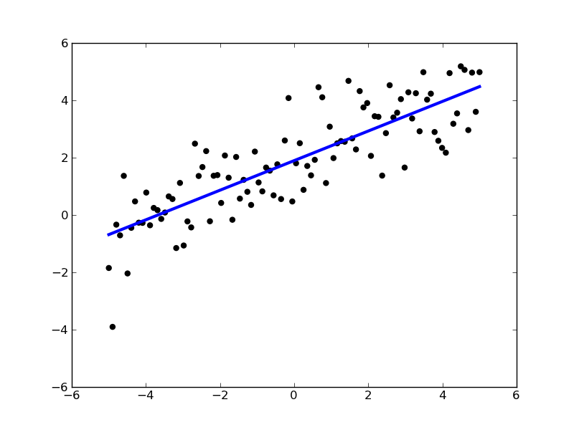

Slide 13
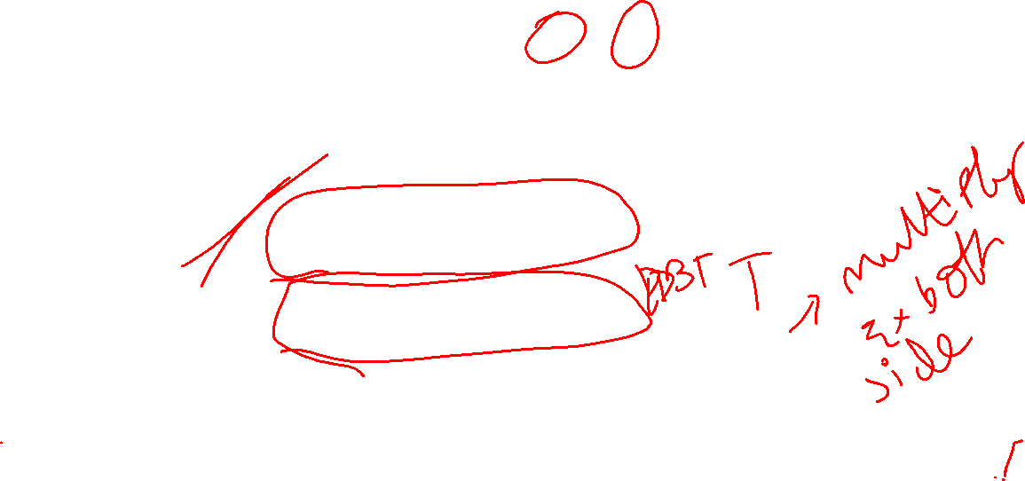


Cont.
The main equation:
In order to determine the value of “a” and “b”, the following two normal equations are to be solved.
“N” is number of years/months/any other periods.

Slide 14
Numericals

